Slide 1
HealthySELFIE
Store and verify health claims on the Ethereum blockchain
Patient-driven EMR with forward-looking consent management & interoperability via blockchain
Workflow
1. eHealth Wallet
2. Ethereum Blockchain
3. Health Data Stores
I. Populate
Sister Sally
IPFS
East Clinic
Smart Contract
HL7 FIR standard EMR
Data: health conditions, allergies, medications
1. uPort digital ID
with “Patient” data attributes per schema.org
My EMR
My Health ID
Live EMR data server, Epic, Argonaut Project, Wisconsin
My Family
My Doctors
2. Request EMR data from health data stores populated to IPFS (Whisper PGP encryption)
Brother Bob
West Clinic
HL7 FIR standard EMR
Father Fitz
Data: genetic testing and forward-consent
Required by Precision Medicine Initiative
3. Tierion HIPAA-compliant audit trail (Bitcoin blockchain)
II. Verify
Quick on-demand attestation look-up from eHealth Wallet to blockchain

Slide 2
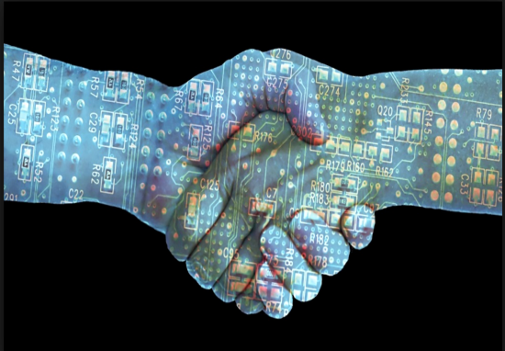
HealthySELFIE
Store and verify health claims on the Ethereum blockchain
Work flow example: establish uPort digital identity via Ethereum smart contract, set up verifiable health claim using schema.org/Patient
Share conditions, medications, allergies, genetic data across family groups

Slide 3
HealthySELFIE
Store and verify health claims on the Ethereum blockchain
Work flow example: Tierion HIPAA-compliant audit-trail

Slide 4
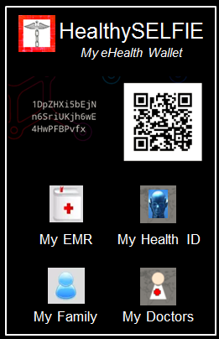
HealthySELFIE
Store and verify health claims on the Ethereum blockchain
Summary: Patient-driven EMR with forward-looking consent management, data liquidity via blockchain
Problem: Non-interoperable medical records
Market-ready for $22 billion worldwide EMR market
Revenue: service provider (Aetna, Cigna, Anthem) with EMR solution, remunerated patient-shared data
Precision Medicine Initiative: share genetic/medical data across family groups
Interoperability/Shared Infrastructure
HL7 FIR open data standard schema.org/Patient (standards-based unified EMR solution)
Use of Blockchain
Ethereum blockchain smartcontracts
uPort self-signed digital identity management system
HIPAA-compliant audit log with Tierion
Technology Stack
Ethereum blockchain smartcontracts, uPort, IPFS, Whisper; HL7 FIR Epic open EMR Argonaut Project

